Slide 1

Modern Windows Development
Choosing the Right UI Framework
Notes:
Welcome folks. In this session we’re going to talk choosing a native Windows UI framework for your next app.

Slide 2
About Me
Software industry for 30+ years
Morning Dew link blog – alvinashcraft.com
Written 4 books for Packt Publishing
Sr. Knowledge Manager at Microsoft – Joined 2022
TechBash Dev Conference organizer since 2016
  TechBash 2027 – October 11-13 – Kalahari Resort Poconos
Notes:
A little bit about me…
I’ve been working in the software industry since 1995, with most of that time (over 25) years spent as a developer and architect using various Microsoft technologies.
Some of you may also be familiar with my blog, the Morning Dew, where I’ve been posting daily links for .NET developers for over 17 years.
I’ve also written three books in the last four years, including two editions of Learn WinUI 3 and a book on parallel programming with C# and .NET. You can find them all on Amazon. Just search for my name.
Writing those books led me to a full-time career in writing. I joined Microsoft about three years ago as a content developer. I write documentation, training modules, and code samples on Microsoft Learn for the Windows developer docs team. Our team maintains the docs for Windows client apps and APIs.
And… in my spare time, I’m also a conference organizer.

Slide 3
Agenda
A brief history of .NET Windows development
Choices covered today – Pros & Cons
  Windows Forms
  WPF
  UWP*
  WinUI & Windows App SDK
  .NET MAUI
  Uno Platform
  Blazor Hybrid with WPF host
Guidelines when choosing a framework
Resources and Q&A
Notes:
Here’s a look the agenda for the next hour.
We’ll start with a brief review of Windows development’s evolution since the introduction of .NET Framework.
Then we’ll review some reasons why you might decide to choose each of these UI frameworks, followed by a look at some code for each of them.
I created the same sample app using each framework. It’s a simple shopping list app that loads a few rows sample data. Each app shares the same code to generate the sample data. You can add more items, mark them as purchased or remove them from your list. We’ll see the similarities and differences, and you’ll see my amazing UI design skills, especially when we get to the Blazor hybrid app.
We’ll finish up with some guidelines you can use when selecting a framework for your next Windows project.
And we’ll review some online resources you can keep handy, and we’ll have some time for Q&A. But feel free to ask questions as we go.

Slide 4

Brief History of .NET Desktop Apps
2002 - Windows Forms
  Successor to Visual Basic 6 forms
  Bill Gates demos the VB form designer in 1991
2006 – WPF
2015 – Universal Windows Platform (UWP)
  Successor to Windows 8 apps - 2012
2021 - WinUI and Windows App SDK (March)
2021 – Blazor Hybrid (November)
2022 - .NET MAUI
3rd party cross-platform options
  Uno Platform and Avalonia UI
Notes:
This is a simplified history of the UI frameworks for .NET developers since .NET’s introduction in 2002.
WinForms has been there for every step of the way. Even before WinForms and .NET, Microsoft has had a forms designer for Windows apps. In 1991, Bill Gates demoed the first VB form designer.
WPF was introduced with Windows Vista in 2006 and was the first XAML-based UI framework from Microsoft. WPF became a big deal for enterprise developers and quickly became the de-facto choice for businesses building enterprise Windows apps on Microsoft’s stack.
We’ll skip over the Windows 8 XAML apps that debuted in 2012 and talk briefly about UWP apps. They were introduced in 2015 with Windows 10, and UWP apps gave developers a way to target Windows on desktops, phones, HoloLens, and Xbox with a single code base. They had some success with ISVs building consumer apps but never got much traction in the enterprise. WPF stayed strong there and many folks started moving to web development.
2021 gave use two new options for Windows apps: WinUI 3 (which ships with the Windows App SDK) and Blazor Hybrid apps. WinUI 3 was launched as a successor to UWP, and Blazor Hybrid apps introduced a way for web developers to build desktop and mobile clients with .NET and Razor pages.
We’ll also talk about some options that allow you to target multiple platforms. .NET MAUI is the successor to Xamarin.Forms, and it allows you to use XAML and C# to build apps for Windows, macOS, and mobile devices. There are some third-party options that we’ll touch on too. Uno Platform and Avalonia UI both target the same platforms as MAUI in addition to Linux and web support (with WebAssembly).

Slide 5
But What About…
React Native for Windows
Progressive Web Apps (PWAs)
Electron.js
Web apps – in your browser of choice
Win32/C++
Flutter
Visual Basic 6
Notes:
We won’t have time to talk about every option available for building apps for Windows. With only 60 minutes and quick demos of each project to get to, we’ve omitted plenty of great options.
React Native for Windows is a great option if you’re a JavaScript developer, as are PWAs and Electron apps (if you users have plenty of RAM).
You could keep your app in the browser with JavaScript, Blazor or ASP.NET Core with Razor pages.
If you’re a hardcore C++ developer, there are new Win32 APIs coming in every new Windows SDK release.
Flutter is Google’s cross-platform app solution that uses the Dart language.
And then there’s VB6.

Slide 6
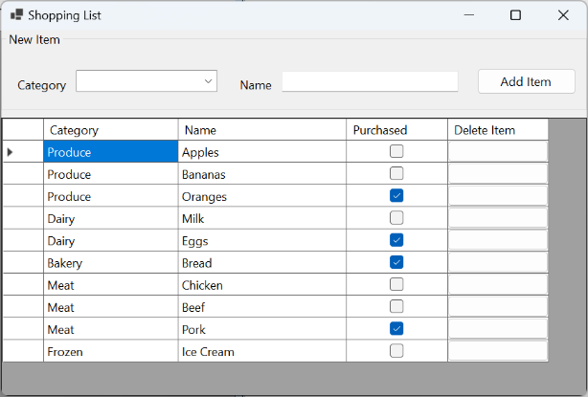
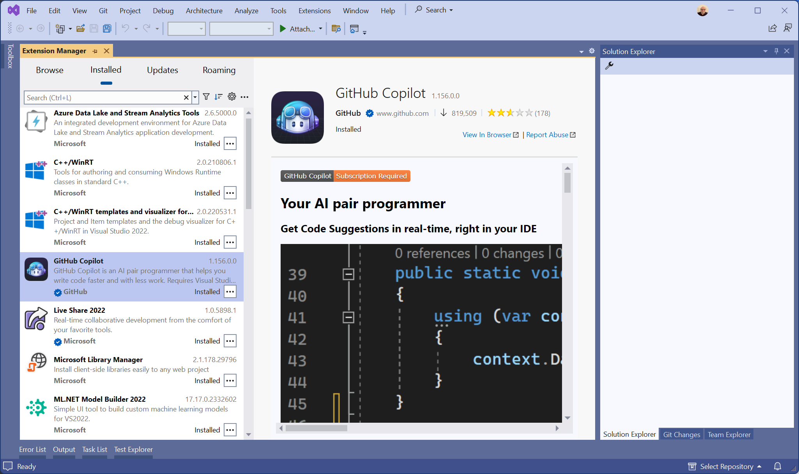
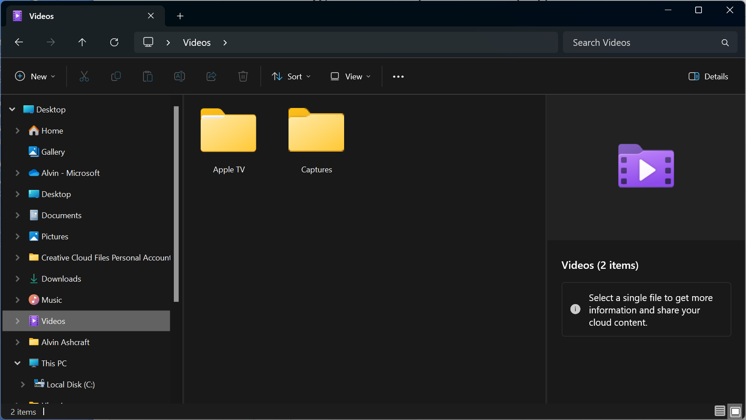
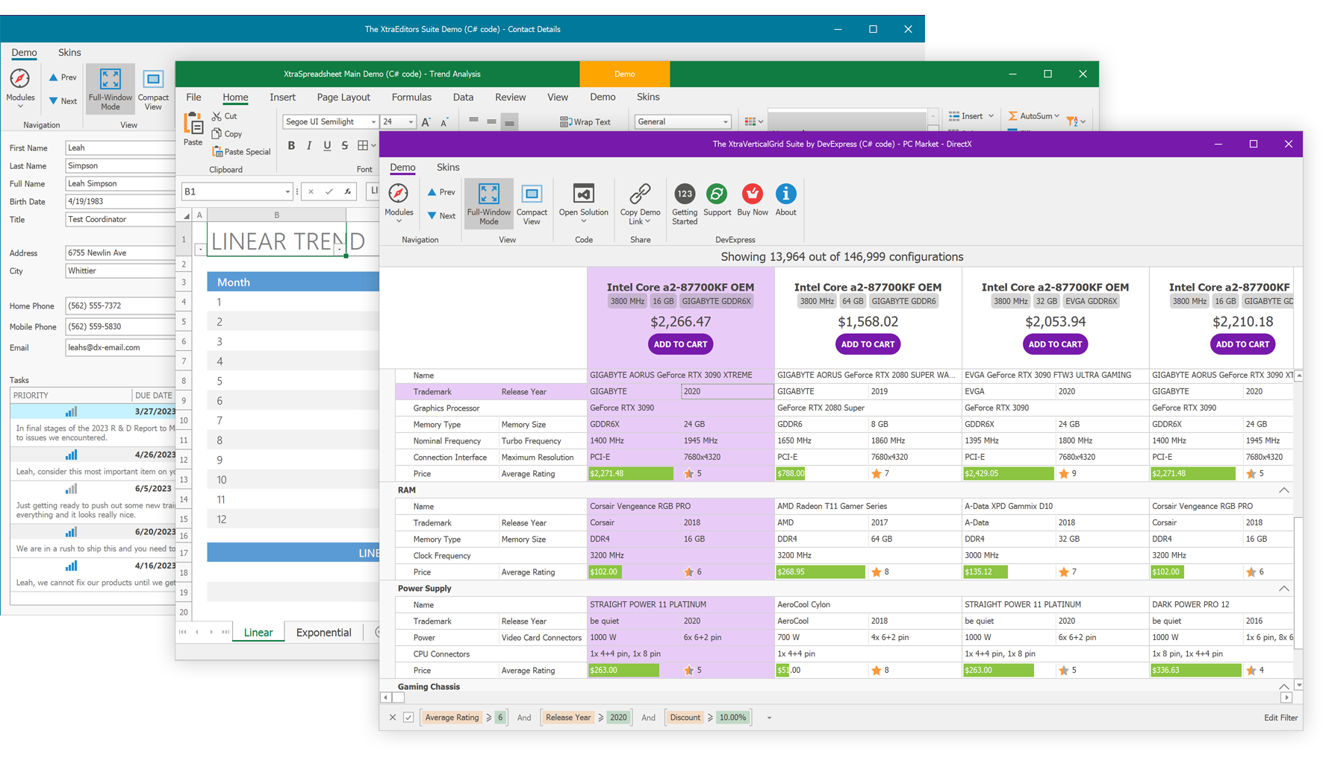
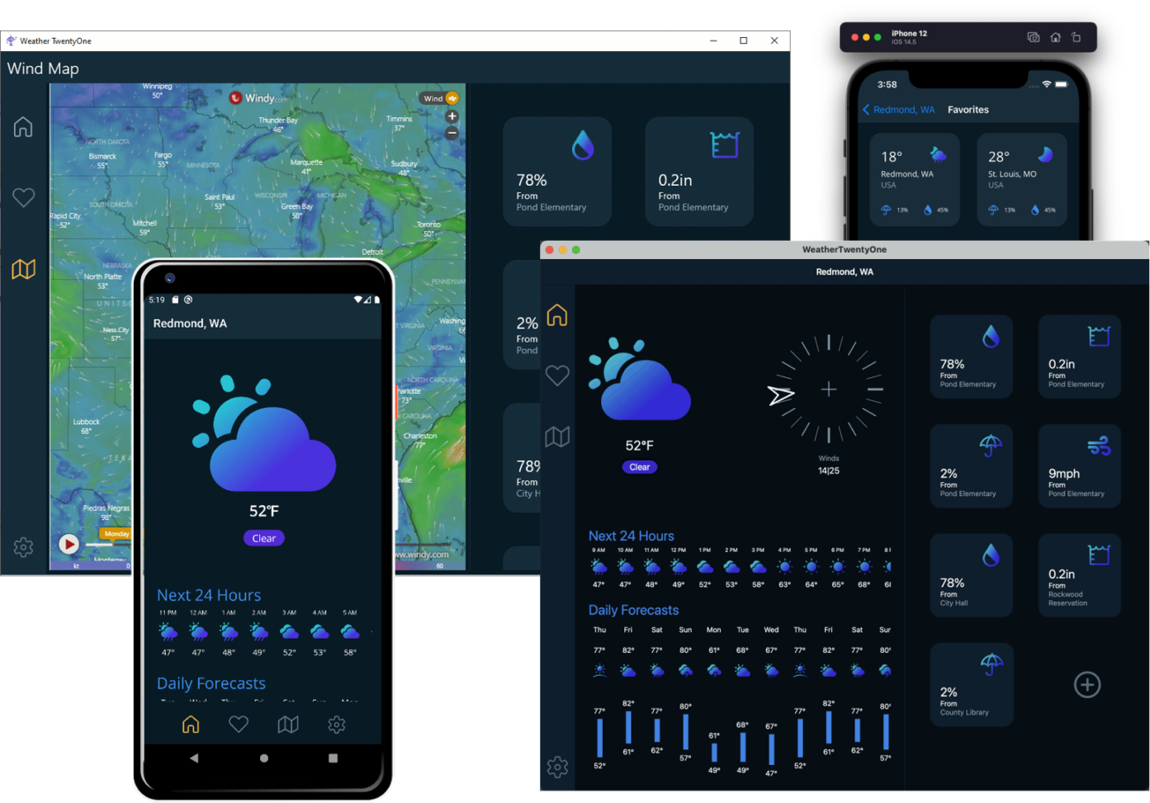
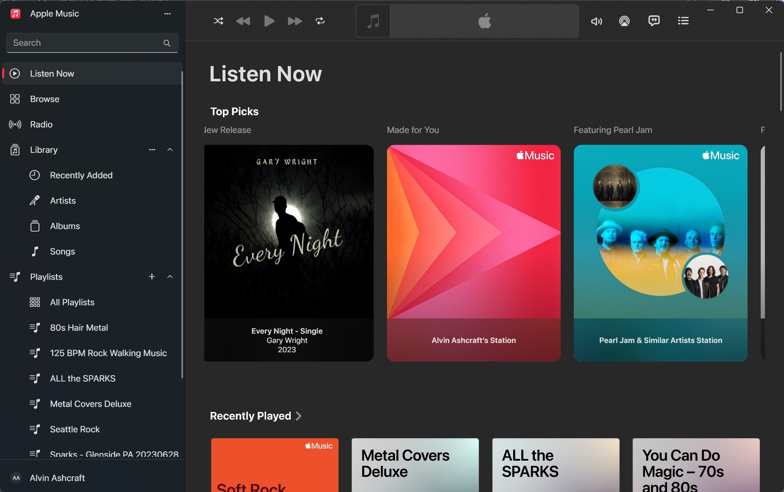
USER INTERFACE EXAMPLES
Notes:
These are a few examples of Windows UIs that were created with some of the frameworks we’re discussing today.
The two on the left are both WinForms.
The upper-left screenshot is probably the type of UI you picture when you hear Windows Forms. It looks very Windows 7… utilitarian. This is a screenshot of the sample app will be exploring later in this session.
The lower left is a WinForms UI with some third-party controls and theming applied. This particular example was taken from DevExpress. With the help of third parties, there’s a lot you can create with modern .NET’s Windows Forms.
The screen in the middle probably looks familiar. That’s Visual Studio 2022. Nearly all the Visual Studio UI is WPF. There are a few remaining legacy dialogs (like the Options dialog), but it’s mostly WPF.
The screens below Visual Studio were created with .NET MAUI. Microsoft built a weather sample app that’s responsive to different desktop and mobile form factors. You can get the source code for this app on GitHub. Just search for .NET MAUI weather sample app.
The top right image is a screenshot of Windows File Explorer in Windows 11. The latest builds of Windows 11 have a File Explorer that was created with WinUI. Microsoft and some key partners like Apple and Adobe have been using WinUI to create some high-profile desktop apps over the last couple of years.
The Apple Music app is the last image here. You can download the Apple Music, Apple TV, and Apple Devices apps from the Microsoft Store. All three were built with WinUI. Adobe’s WinUI app is called Fresco, you can also install Fresco from the Microsoft Store.

Slide 7

Windows Forms Advantages
Rapid UI development
3rd party controls & themes
Stable dark mode support in .NET 10
Modern & legacy options
  .NET Framework
  .NET 11
  Upgrade with GitHub Copilot
Under active development
  Roadmap on GitHub
Every C# developer is a WinForms developer
Notes:
Let’s get into some details with each framework, starting with Windows Forms. WinForms is probably still the most used Windows framework when it comes to starting a new project.
.NET developers love WinForms because it lets you build apps fast. It has a visual drag & drop designer to build your UI, and everything is C# (or VB) code. There’s no separate language or markup used to build the UI.
As we saw on the previous slide, there has been strong third-party support for WinForms controls for years (decades, really).
You have two options when you create a new WinForms project. You’ll typically want to select the modern .NET option (that’s .NET 9 today), but you still do have the option to create a new WinForms project on .NET Framework. The templates for both are part of Visual Studio 2022. If you have clients running unsupported Windows 7 machines, you can still build and maintain .NET client apps for them.
If you have existing .NET Framework WinForms apps that you’d like to modernize, Microsoft has a .NET Upgrade tool you can use to move them to .NET 9 to take advantage of the performance and features of today’s .NET.
This tool can also upgrade legacy WPF apps to WPF on .NET 8, Xamarin.Forms apps to .NET MAUI, or UWP apps to WinUI. The tool will also provide a list of any issues encountered during the upgrade.
Windows Forms is still supported and under active development. There are some new async APIs and experimental Dark Mode support in .NET 9. You can visit this page on GitHub to review their public roadmap and see upcoming features.
Because there’s no XAML, CSS, or any other UI language to learn. Every .NET developer can be a WinForms developers.

Slide 8
Windows Forms Drawbacks & Demo
Looks like Windows Forms – Dated UI
No GPU acceleration
No C++ support
Not great for Touch & Pen input
WinForms Demo
Notes:
Let’s briefly touch on a few reasons why you might not choose Windows Forms, and then we’ll look at the sample app.
Without any custom theming applied, WinForms looks dated. It’s had some updates to improve the UI over the years, but you won’t be implementing Microsoft Fluent Design in a WinForms app any time soon.
The XAML-based frameworks can take advantage of rendering on modern GPUs, improving the performance of complex UIs.
There’s no C++ language support for WinForms projects (or F# for that matter). It’s C# and VB only.
The built-in support for switching between light & dark themes when users update their Windows theme has been added as an experimental feature in .NET 9. We also saw earlier that there are third-party theming options for with light and dark themes though.
It’s also not the best choice if touch input or inking are important to your users.
OK, let’s look at some code!

Slide 9

WPF Advantages
XAML designer
XAML Hot Reload for UI debugging
GPU Accelerated UI
Rich data binding - MVVM
Modern & legacy support (.NET Framework or .NET 11)
Extensive 3rd Party control & library support
Active development
  Roadmap on GitHub
  Windows 11 theming support & UI refresh in .NET 9
Great for Enterprise apps & multi-window
Notes:
Next up is WPF…
WPF apps have a XAML-based UI. If you’re not familiar with XAML, it’s a schema-bound XML markup language with support for data binding, styles, and loading static and dynamic resources.
Visual Studio provides a UI designer for WPF, as well as XAML Hot Reload for making simple UI changes while debugging without having to stop and start your debugging session. Visual Studio doesn’t always generate the best XAML when adding or moving items in the designer, but it’s a great tool for learning or to use as a preview tool when manually editing the XAML.
As I mentioned on the WinForms slide, XAML-based UIs are GPU accelerated, which means they’re rendered by the DirectX pipeline. This helps with UI rendering performance, offloading some work from the CPU.
Data binding in WPF is extremely powerful and lends itself to using the Model-View-ViewModel (or MVVM) pattern. Visual Studio also has tools for debugging data binding errors and for analyzing the WPF visual tree – that’s the hierarchy of controls/elements in the UI.
Like WinForms, WPF has .NET 9 and .NET Framework project options and extensive third-party library support.
It’s under active development, and if you check out the roadmap on GitHub, you’ll see that they’re working on built-in theming support for Windows 11 in .NET 9. WPF apps will finally have a more modern look out-of-the-box. We’ll see it in a minute.
WPF is the framework of choice for many companies building complex line-of-business apps for Windows today.

Slide 10
WPF Drawbacks & Demo
XAML learning curve
No C++ support
Better for touch and pen input; not best in class
UI performance not as optimized as WinUI
WPF Demo
Notes:
The primary downside for many developers considering WPF is the XAML learning curve. I love working with XAML, but it’s not everyone’s favorite way to build a UI.
Like WinForms, it’s C# and VB only. There’s no C++. If you are a big F# fan, you could create a minimal UI project with only the C# views and create a separate F# project for your view models, business logic, and everything else.
The Windows theming and dark mode switching is still on the way. But it’s now available in .NET 9. It’s almost time to remove this bullet point from the slide instead of just using strikethrough.
It’s better for touch and pen than WinForms, but it wasn’t built for today’s devices like WinUI.
Performance-wise, it’s better when you use .NET 9, but there are some improvements in the rendering pipeline that make UWP and WinUI user interfaces smoother.
Let’s look at the WPF sample app next.

Slide 11

UWP Advantages*
.NET Native optimization
  Built to perform on Windows, Xbox & Windows Phone
XAML designer
Great for touch and pen
Windows themes (Dark Mode)
Rich data binding - MVVM
WinUI 2.x controls & libraries
Security with Windows Sandboxing
New support for modern .NET upgrade
  Path to WinUI migration
Notes:
Let’s briefly talk about UWP apps next. We’ll touch on some advantages, but the drawbacks on the next slide should weigh heavily on your decision.
Thanks to Windows Phone, UWP apps are optimized for performance. They are small and memory-optimized with the .NET Native runtime.
It technically supports HoloLens and Xbox, but HoloLens is officially deprecated, and I haven’t heard folks pushing UWP developers to build Xbox apps in a long time.
Like WPF, Visual Studio has a XAML designer for drag & drop UI building.
UWP apps were built for pen and touch and provide dark mode support.
Like all XAML languages, you have data binding and testability with MVVM.
The WinUI 2 libraries provide some additional controls with some Fluent design support, and additional helpers & styles.
UWP apps are sandboxed, which means they have limited access to the file system and other Windows resources. This provides users some additional security from bad actors. Like mobile apps, they need to declare any advanced capabilities or access required so users are aware of what data might be accessed. There’s something like this coming for all packaged desktop apps called AppSilo, which should be released in the fall.
And now in preview in .NET 9, you can create UWP apps with the latest .NET and C# features. This was added to ease migration to WinUI and also to get people off of the old .NET Native runtime. UWP is still in maintenance mode. No new features…. Which brings us to the cons.

Slide 12
UWP Drawbacks & Demo
No more feature updates
  Bug fixes & security updates only
  No new features for WinUI 2
.NET Native means no modern .NET features or optimizations
  No C# 8 or later features in classic UWP
  .NET 9 added an upgrade path for UWP
No Fluent UI updates (Windows 10 UX)
Unknown Support Lifetime
.NET Standard libraries
MSAL libraries dropped UWP support
Coupled to Windows SDK versions
UWP Demo
Notes:
<10:35>
The downside of building UWP apps.
Well, unless you have a great reason, I don’t recommend building a new app with UWP today.
While it’s still going to be supported by Microsoft for the foreseeable future, it’s getting no new features. That includes the WinUI 2 controls. They’re both only getting critical security updates and bug fixes.
.NET 9 support is in the works but still in preview…
While .NET Native is small and fast, it’s also aging. With current production UWP projects, you don’t’ get access to modern .NET or language features. In fact, you can’t officially use any C# language features beyond C# 7 (and we’re up to C# 12 now in .NET 8 – it’s always the .NET version plus 4). It requires some work-arounds, and you’re better off just choosing another UI framework.
While WinUI 2 has some Fluent design look & feel, it’s Fluent 1.0, which is the Windows 10 look and feel. The Windows 11 look is Fluent 2.0. You can’t get that in UWP without some work on your part to style it, or there may be some third-party options out there.
UWP relies on .NET Standard for shared libraries, like when you’re consuming NuGet packages, and Microsoft has been moving away from that .NET Standard. Today, just using modern .NET is the standard feature set across platforms. That move leaves UWP behind. In fact, the Microsoft Authentication Libraries (MSAL) just announced that they are dropping support for Xamarin and UWP in their NuGet packages moving forward. I expect others will follow suit. I don’t know if this stance changes for UWP projects on .NET 9, but I suspect it could.
Finally, UWP versions are tied to Windows SDK versions. We’ll see how WinUI separated itself from this dependency on the Windows SDK.
Let’s take a very quick look at the UWP Shopping List app.

Slide 13

WinUI Advantages
Windows 11 Fluent Design
Best of UWP without coupling to Windows SDK
Frequent Windows App SDK updates
  1.6 – C# Native AOT; TitleBar improvements
  1.7 – OAuth2, BackgroundTaskManager, CameraCaptureUI
  2.0 – Storage Pickers, WebView2 drag support
  Roadmap on GitHub
win-dev-skills, winapp CLI and msstore CLI – Accelerate AI development
VS Code extensions – WinApp (Microsoft) and WinDev Helper (mine)
C# and C++ support
Rich data binding - MVVM
Great for modern experiences & hardware
  Touch and pen input
Upgrade from UWP with GitHub Copilot
Top choice to build modern native Windows apps
Notes:
Now we’re talking WinUI…
WinUI is the UI component of the Windows App SDK. The UI framework is technically called WinUI 3, but with WinUI 2 becoming a legacy product, the team is leaning into using simply WinUI as the name.
It supports the latest Fluent design concepts, so you get the most modern looking apps with the least amount of effort/coding. They’ll match the look and feel of the in-box Windows 11 apps.
You get the features and controls of UWP without being coupled to a specific version of the Windows SDK. The Windows App SDK updates multiple times a year. With WinUI project in C#, you also can potentially access APIs from the .NET SDK, Windows App SDK, and WinRT APIs in the Windows SDK.
Some of the recent updates brought some XAML Islands support, Theming, Notifications, improved multi-window support with AppWindow, and media controls. The most recent Windows App SDK, version 1.5, brought the much-anticipated Maps control to WinUI. It was one of the top requested features.
1.6 laid the groundwork for some new features coming in 1.7 including Inking controls, TableView, and cross-process Islands. It also brought C# Native AOT (ahead-of-time compiling) for faster startup times and smaller memory footprints. We’ll get to some other feature requests on the roadmap on the next slide. 1.7 has some experimental releases available and has Camera Capture UI and long-awaited OAuth support.
You can check out the current Windows App SDK roadmap on GitHub.
Like UWP, it’s great for data binding with MVVM, touch & pen input.
You can upgrade apps from UWP with the .NET Upgrade Assistant.
You can also get even more free controls and components for WinUI with the Windows Community Toolkit and .NET Community Toolkit. You can read more about leveraging them in my WinUI 3 book.
Finally, Microsoft is really positioning WinUI as the top choice for developers to build the best apps for Windows. You can see that commitment in their partnerships with Apple & Adobe to bring high profile, first-class apps to Windows.

Slide 14
WinUI Drawbacks & Demo
No XAML designer in Visual Studio
  Work started on designer in Windows App SDK 1.7, but quiet since
  XAML learning curve
  XAML Hot Reload for UI debugging
No F# or VB
  C# and C++ only
No Xbox (UWP upgrade path)
No built-in UI data validation(yet?)
  A top requested feature
  Workarounds (see my book, Learn WinUI 3)
WinUI Demo
Notes:
Let’s discuss a few drawbacks with WinUI. It’s currently the best option for most scenarios today if you’re building a native app for Windows.
However, the biggest barrier for entry for new XAML developers is the lack of a UI designer in Visual Studio. This has been the top request since WinUI’s release three years ago. The product teams are aware that it’s wanted. The team announced late last year that work on a designer will be starting in Windows App SDK 1.7.
I think they could satisfy many people by releasing a read-only UI preview for design-time. If you could see what you’re building in the XAML without starting a debugging session, it would be a huge quality-of-life improvement for WinUI developers. Right now, it requires debugging the app and relying on XAML Hot Reload to experiment with UI changes in the debugging session.
Next, WinUI apps only support C# and C++. There’s no support for VB or F#. Like I mentioned with WPF, you could create a minimal UI project with only views and reference a VB or F# project to access the view models and the rest of your code.
If you’re porting a UWP app to WinUI, you’ll have to leave the Xbox and HoloLens support behind. WinUI is Windows desktop only, unless you’re using something like Uno Platform.
Finally, another highly requested feature on the team’s GitHub repo is data validation for WinUI controls. This one could make it into the framework eventually, as there was an implementation started while WinUI 3’s first release was still in preview. If you have a copy of my WinUI book, I added data validation to an app using a workaround that’s easy to add to your own apps.
Now let’s look at the WinUI app. This one has a basic MVVM implementation.

Slide 15

.NET MAUI Advantages
Cross-Platform (Windows, Android, iOS, macOS)
  Platform-specific implementations
  MAUI helpers
  Native UX per platform
Easy to Learn for XAML developers
  Xamarin migration with GitHub Copilot
  Rich data binding - MVVM
MAUI Community Toolkit (open-source libraries)
Create UI in C# with C# Markup
  MVU (Model-View-Update) pattern
Uses WinUI for Windows apps
Develop with Visual Studio, JetBrains Rider or VS Code
Web developers have Blazor Hybrid to build in MAUI
Roadmap on GitHub
Notes:
Now we’re getting into the cross-platform options. While these technically aren’t “native Windows options”, they do output a WinUI app for Windows.
If you want to build an app for Windows, and you’re also thinking about targeting other platforms, you have several options. Microsoft’s cross-platform option is .NET MAUI, the successor to Xamarin.Forms, which is just days away from retirement.
MAUI apps can be deployed to Windows, Android, iOS, macOS, and Samsung Tizen devices (watches and TVs). Linux support is often requested, but it’s not yet supported.
With MAUI, you can create a single codebase to target all their supported platforms.
- You can create platform-specific code to access native functionality.
- MAUI also has helpers to wrap many common device functions (like accessing the file system, camera, location, etc).
- To create platform-specific UI in your XAML, there’s an OnPlatform markup extension to light up parts of the UI.
If you’ve built other XAML apps, picking up .NET MAUI is simple. The layout, styling, and binding are all similar. Some controls have slightly different names. It supports MVVM for separate of concerns and data binding.
However, you can also create your MAUI UI entirely in C# with the .NET Community Toolkit and C# Markup. When doing this, you can use the MVU pattern, which is similar to how Google’s Flutter apps are typically built.
When a MAUI app is compiled and deployed to Windows, it’s creating a WinUI app under the covers. So, the MAUI team is dependent on the WinUI team for any native Windows controls to be available. Having the Map control now available in WinUI helps MAUI developers too.
When building .NET MAUI apps, you can use Visual Studio or VS Code on Windows. On macOS, VS for Mac is no longer going to be supported, but developers can use the support in the VS Code extension.
There’s also a Blazor Hybrid app template for .NET MAUI. This allows you to build your UI with Razor components which get hosted inside a custom WebView control in the MAUI host app. There’s a session on hybrid apps in .NET MAUI later today in this room.
We’ll also touch on building Blazor Hybrid apps for Windows later. You’ll see how you can take the Blazor Hybrid approach on desktop with WPF or WinForms WebView hosts.

Slide 16

.NET MAUI Drawbacks & Demo
Platform-specific code required for some native features
No XAML designer in Visual Studio (use Hot Reload)
Official C# support only
  No C++, F#, or Visual Basic
  Use F# with Blazor Hybrid
Windows support is there but iOS/Android are top priorities
  Use WinUI if Windows is your primary target
Some limitations on UI customization
Performance – improving each release
.NET MAUI Demo
Notes:
Some MAUI drawbacks.
The more platform-specific code your apps needs, the more complex your project will get. If you’re relying extensively on device hardware features, be prepared to have some platform-specific implementations to maintain in your code.
Like WinUI, there’s no XAML designer to build your UI. You will need to rely on Visual Studio Hot Reload.
MAUI is C# only right now. No official support exists for VB, F# or C++. You can use F# in a Blazor Hybrid app for MAUI (in your razor components).
Today, more developers are using MAUI for iOS & Android than they are for Windows. The team’s top priority now is getting developers ported from Xamarin to MAUI, as support for Xamarin ends in a few days. So, Windows features and non-critical bugs in the backlog are probably not high on the list.
If you’re a more advanced XAML developer and use control templates to heavily customize your UI, not all MAUI controls support templating yet (like the Button control).
While .NET 9 is fast, any kind of abstraction like MAUI or Flutter is going to be less performant than building native apps.
Let’s look at the .NET MAUI shopping list app for Windows.

Slide 17
Blazor Hybrid – Web in a Native Shell
Pros
It’s web - no XAML learning curve
Powerful CSS styling
.NET compatibility
Use WPF or WinForms desktop hosts
Use .NET MAUI host for mobile
Cons
Interop has costs
  Performance
  Bugs?
  Accessibility quirks
  Support across two products
Can feel like web
Notes:
Blazor Hybrid on Windows (or mobile)
Pros
- No XAML learning curve. If you know Razor pages and C#, you’re ready to go!
- Again, web developers will love working with CSS instead of XAML styles.
- You’re building web and using .NET. Your app can consume any other modern .NET libraries.
- You can build your hybrid app inside WPF or WinForms, which makes it easy to integrate with your existing apps on those platforms.
Cons
- Interop has its costs…. Performance, maybe bugs in the interop layer?, issues with accessibility, keyboarding, you’re dealing with support across desktop and web products.
- It feels like a web app… it’s got that bouncy feeling when you drag things around.
Let’s take a very quick lap around a Blazor Hybrid app.

Slide 18
Uno Platform & Avalonia UI
Pros
XPlat (Windows, Android, iOS, Mac, web, Linux)
  Platform-specific implementations
Windows platform options
  Use Skia to run on Windows 7 and later
  Use WinUI to run on Windows 10 (v19041) & later
Uno views/VMs nearly identical to WinUI
  Copy/Paste simple projects
C# Markup w/ MVU or XAML w/ MVVM
Figma Plugin
Uno Platform Studio & Hot Design
Theming: Fluent, Material & Cupertino
Develop in Visual Studio, VS Code or Rider
Cons
No VB or F#
3rd party solution
Pay for Advanced Support
Platform-specific code required for native features
Notes:
PROS
Advantages of using a 3rd party cross-platform solution like Uno Platform or Avalonia UI.
You get all the MAUI platforms plus Linux!
With Uno, you can even use Skia.WPF to run on older platforms like Windows 7. If you’re only targeting Windows 10 or later, you’ll want to choose the WinUI option.
WinUI Uno project code is nearly identical to WinUI code. I created an Uno app for my book by creating an Uno Platform project with their new project wizard and copy/pasting my WinUI project code (XAML and C#). It just works for most basic apps. Like other cross-platform code, it gets more complicated with device-specific functionality.
You can use C# Markup or XAML to build your UI. The new project wizard will ask you which you want to use.
Uno has a Figma plugin so your design team can design your app screens and generate your Uno pages.
Uno can create apps with Microsoft Fluent, Google Material or Apple’s Cupertino look and feel.
Uno has plugins for Visual Studio, VS Code or JetBrains Rider. So, you can build apps with your favorite editor or IDE.
CONS
Some of the drawbacks of platforms like Uno…
No official support for VB, F# or C++.
It’s a 3rd party solution. Some companies that use Microsoft solutions can be hesitant to work with 3rd party platforms.
There are paid options for advanced support. Avalonia also has licensing terms for app deployment.
Like with WinUI and .NET MAUI, there’s no XAML designer.
You have the platform-specific code issue we discussed with MAUI app development.
And there are similar cross-platform vs native performance concerns we discussed with MAUI.
Let’s take a quick look at the Uno version of our WinUI shopping list app.
If there’s time, we’ll bring up the new project wizard to look at the options there.

Slide 19
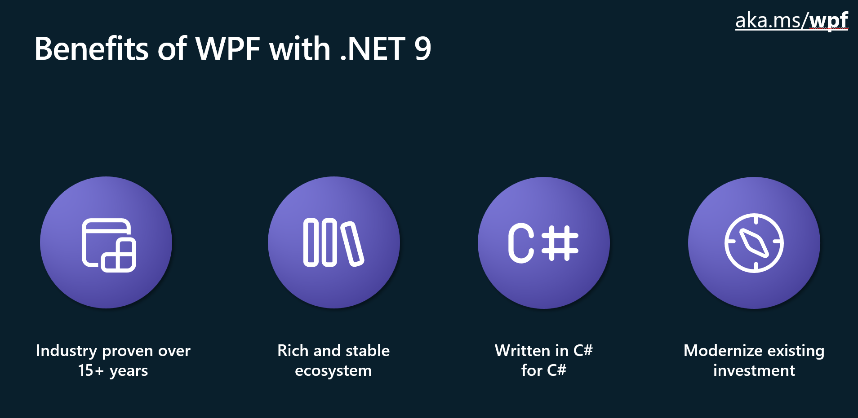
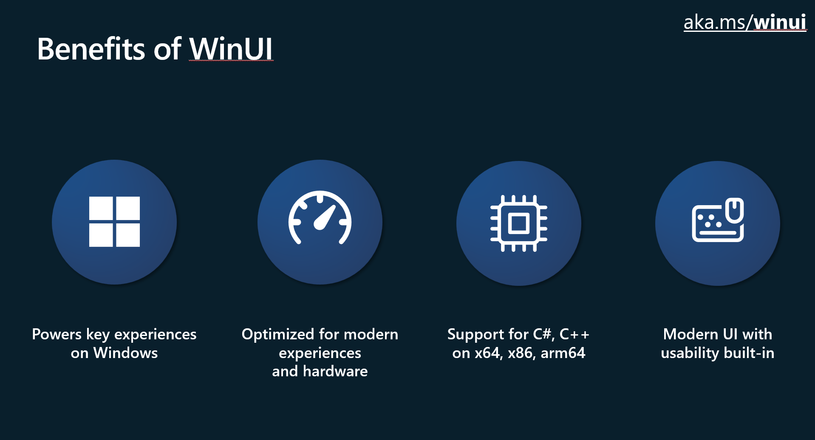
Making a Choice
Programming Language
UI Framework
Drag & Drop Designer
UI Design Language
.NET Support
Legacy Windows Support
Touch Support
Cross-platform Options
Long-term Support Options
Current Features & Public Roadmap
Notes:
Some things to consider when deciding what to choose for a new Windows app…
The top recommendations today are WPF and WinUI for native Windows apps. For cross platform .NET development, you’ll typically go with .NET MAUI. For the reasons to use WPF and WinUI, you should watch the “Navigating Win32 App Development with WinUI and WPF” session from Microsoft Build. These two slide images are from that slide deck. I have the link to a GitHub page with links to several sessions and other resources from Microsoft’s WinUI team in my GitHub folder for this presentation. The next slide has that link and more.
What programming language does your team use?
Does your team have experience with existing UI frameworks?
Do they know XAML? Do they like it?
Do you need a UI designer in Visual Studio?
Do you need Fluent Design (or another design system)?
Do you want to work with .NET – maybe flutter or electron works better for your developers.
Do you need to support older Windows versions?
How about touch and pen support? How important is that experience?
Do you need cross-platform? Or do you think you will in the future?
Are you porting an existing solution? Unless you’re on Xamarin or UWP, there’s no reason you NEED to change your selected framework.
How long do you expect to support your app? If you’re in it for the long haul, make sure you’re using a framework that can support upgrading with .NET long-term support versions every two years.
Do the current features of each platform meet your needs? Are there missing features on the product roadmap?
What does Microsoft recommend? Well, if WinUI and Windows App SDK has the features you need, you should choose that. From the Windows team’s perspective, it’s the hero framework moving forward. If it doesn’t have what you need, look at WPF. WPF is also great for building complex, enterprise apps with multiple Windows. If you’re modernizing an existing WPF app, WPF with .NET 8 or 9 is probably your best choice. It’s still getting new features and is not going anywhere.
Absolutely don’t want to touch XAML and love .NET? You can use C# Markup with Uno or MAUI for cross-platform options, or you can stay native to Windows go with the tried-and-true WinForms option.

Slide 20
Resources
Overview of Windows Development Options: https://learn.microsoft.com/windows/apps/get-started/
Uno Platform Documentation: https://platform.uno/docs/articles/intro.html
Avalonia Docs: https://docs.avaloniaui.net/
Build a WPF Blazor Hybrid App: https://learn.microsoft.com/aspnet/core/blazor/hybrid/tutorials/wpf
My Books on Amazon: https://www.amazon.com/stores/author/B08WLD35BX
About Me with Social Links: https://about.me/alvinashcraft
My session materials on GitHub: https://github.com/alvinashcraft/speaking/
Notes:
Here are some resources you can use to help your team decide which platform to choose for your next project.
You can get this slide deck on my GitHub “speaking” repo (alvinashcraft/speaking), along with a larger list of links and the two Visual Studio solutions I used today.

Slide 21
Thank You and Q&A
Any questions?
Thank you!
Notes:
That’s it!
Any other questions or thoughts?
If you have questions or want to chat later, you can find me here this week.
Make sure to leave feedback.

